Slide 1
Sound, Animation and Video
Understanding Sound
Common file formats for digitized sound
Sound on the Web
Frame animation
Path animation
Common animation file formats
Animation on the Web
Common digital video file formats
Planning, shooting, editing and distributing digital video
Video on the Web

Slide 2
Sound
To use sound in a multimedia, you need a basic understanding of sound.
Sound is used in multimedia applications in order to achieve the following:
    Easily capture the attention of users
    Facilitate easy learning
    Set the mood

Slide 3
Sound
To use sound in a multimedia, you need a basic understanding of sound.
Sound is used in multimedia applications in order to achieve the following:
    Easily capture the attention of users
    Facilitate easy learning
    Set the mood

Slide 4
Sound
Sound can:
Set a mood → http://www.mustangdrive-in.com/
Sell, Sell, Sell → http://www.csd.uwo.ca/~lreid/cs033/sound/awardwinningpoo.wav
Educate/Present Information → (www.zodiak.com)
Allow communication over the web via Internet Audio Conferencing or Internet telephony (Skype)
    allows two-way, full-duplex audio conversations over the Web. With Internet telephony you can talk to friends or family without the cost of a long-distance phone call.

Slide 5
Sound
Where can you get sound?
Purchase a cd → must watch for copyright infringements when using sound on your site
http://www.csd.uwo.ca/~lreid/cs1033/sound/captureusingaudio.wmv
Download sound from companies → e.g. http://www.istockphoto.com/index.php
(search for background music, then cow mooing)
http://www.a1freesoundeffects.com/cartoon.html
Download from iTunes and other musical site

Slide 6
Sound
Where can you get sound?
Create your own sound:
  Recording program with a computer's operating system(such as Sound Recorder) and speak into a microphone attached to the computer – quality will not be the best
  Recording studio with equipment such as DAT (Digital Audio Tape) devices that record sounds digitally. Produces a high quality commercial product
  Electronic instruments such as synthesizers can be used to create music sound files. Connecting the instrument to a computer allows the sounds to be captured in a MIDI (Musical Instrument Digital Interface) format.

Slide 7
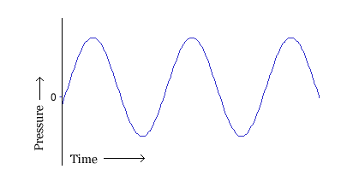
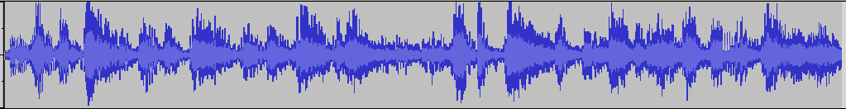
What is Sound?
Sounds are pressure waves of air
Visualize the sounds as a series of
recurring waves called a waveform.
Volume - the higher the wave the
louder the sound
Pitch or frequency
- the closer together the waves
the higher the pitch
Play audio clip
Bells
Oh

Slide 8
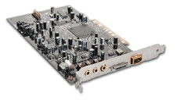

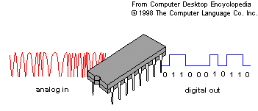
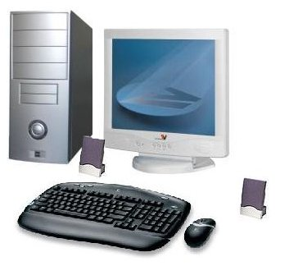
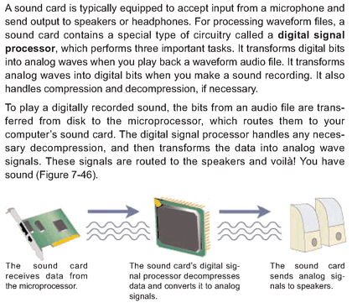
How is Sound Recorded?
Computers have a sound card which converts the sound wave from a microphone (analog to digital)
This conversion is done through a process called Sampling, in which every fraction of a second a sample of a sound is recorded into digital bits.
Laptops rarely have a sound card because manufacturers incorporate sound circuitry into system board
Sound card has:
(ADC) Analog-to-Digital Converter for recording
(DAC) Digital-to-Analog Converter for playing audio.

Slide 9
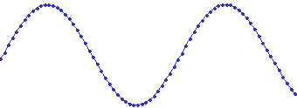
How do computer Represent Sound?
In a multimedia application sound must be
in a digital form (string of 1s and 0s).
Each dot in the figure represents one audio sample
To convert analog sounds to digital sounds
→ thousands of samples are taken of the sound waves and recorded as bits.

Slide 10
QUALITY OF DIGITAL RECORDING
DEPENDENT ON
Sample Rate
Sample Size
Channels
Codecs

Slide 11
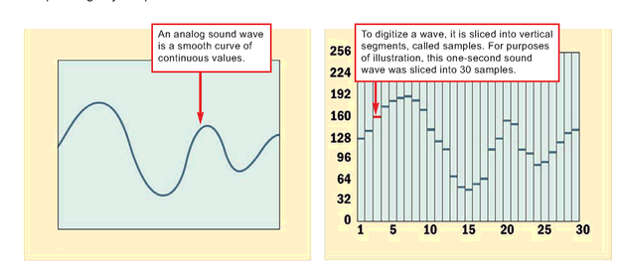
QUALITY OF DIGITAL RECORDING
- SAMPLE RATE -
SAMPLE RATE
  # of samples taken in a second
  Number of times/sec that the waveform is measured
  1000 samples per second = 1 KHz (1000Hz)
1 sec
1 sec

Slide 12
QUALITY OF DIGITAL RECORDING
- SAMPLE RATE -
Reminder:
Number of times/sec that waveform is measured
1000 samples per second = 1000Hz = 1 KHz
We MUST take 2 or more samples per wave
(known as Nyquist Limit)
Question: what is the advantage of taking lots of samples per wave
→ (better sound)
Question: What is the disadvantage of taking lots of samples per wave
→(bigger audio file)
8 KHz VOICE ONLY
22 KHz MUSIC FILES

Slide 13
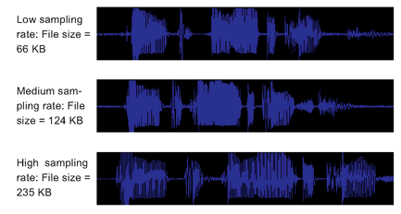
QUALITY OF DIGITAL RECORDING
File Size and Sample rate
SAMPLE RATE
Number of times/sec that waveform is measured
1000 samples/sec
= 1000Hz
= 1 KHz
8 KHz VOICE ONLY (telephone quality)
11.025 KHz AM Quality
22 KHz FM Quality
44.1 KHz CD

Slide 14
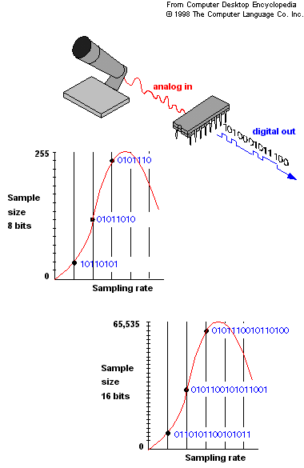
QUALITY OF DIGITAL RECORDING
- SAMPLE SIZE -
SAMPLE SIZE (aka bit depth)
Each measurement taken is represented by a value
How many bits do we use represent that value?
  →The higher the sample size – better sound, bigger file

Slide 15
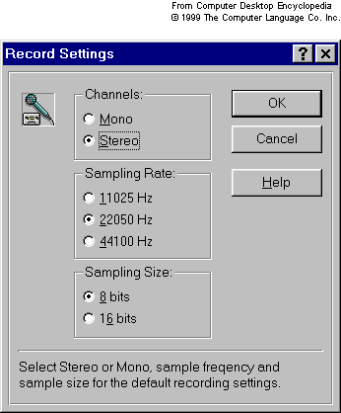
QUALITY OF DIGITAL RECORDING
- CHANNELS -
(3) CHANNELS
Mono vs. Stereo
Mono signal
      one channel( stream) of data reproduced equally on both speaker channels
Stereo signal
      consists of two channels (streams)of data
      double the size of mono file, but higher quality

Slide 16
QUALITY OF DIGITAL RECORDING
- CHANNELS -
(4) CODECS
Software programs that greatly reduce the audio file size
Codecs for audio use lossy compression
  Removes redundant and less-significant data
  Each time compression applied, quality of level of the file diminishes
  See file formats section for compression use (.mp3, .ra )
Common File Formats that are uncompressed:
  .wav (very common, 44KHz, 16bit)
  .aiff
  .cdda (Red Book) → standard for CDs, 44KHz, 16 bit per sample, 2 channels.

Slide 17
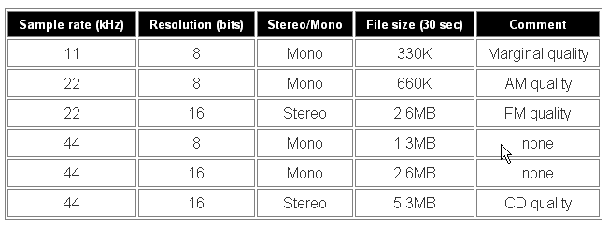
QUALITY OF DIGITAL RECORDING
- CODECS -
SUMMARY
Combine Sample Rate, Size Size, Channel
Higher sampling rate & higher sample size, the more accurately sound can be digitized.
Quality of the digitized sound gets better
1 KHZ = 1000 cycles per second

Slide 18
QUALITY OF DIGITAL RECORDING
In Audacity,
Settings are in
Edit >Preferences

Slide 19
How big can audio get?
An example of uncompressed sound with CD quality for 1 minute of audio:
  1 minute of recording → 60 seconds
  60 * 44,100 samples/second → 2,646,000 samples
  2,646,000 samples * 16bits per sample → 42,336,000 bits
  42,336,000 bits * 2 (stereo, 2 channels) → 84,672,000 bits
  84,672,000 bits / (8bits per byte) → 10,884,100 → About 10 MB (Megabytes)!!!

Slide 20
QUALITY OF DIGITAL RECORDING
The size of a file is a constant calculation based on:
    Sample rate
    Sample size (bit Depth)
    number of channels (mono or stereo),
    codec
Comparison of file sizes for an
uncompressed 16 bit, 44.1 kHz WAV music file:
Size in Bytes | 1 minute | 2 minutes | 3 minutes
Mono Stereo | 5,168 (5.2 MB) 10,336 (10.3 MB) | 10,336 (10.3 MB) 20,672 (20.6 MB) | 15,504 (15.5 MB) 31,007 (31 MB)

Slide 21
Sound-Editing Software
Sound editing programs characteristics
record sounds in different sample sizes and resolutions
save sounds in different file formats
In addition to:
Edits: unwanted noise, pauses, trimming
Fade-ins, fade-outs, background music,
special effects
Several files can be mixed or
spliced together
  Save the file in a format intended for the audience application
  Most sound files are saved in .mp3 , .wav.

Slide 22
Sound on the Web
Using audio on the Web?
Audio files are quite large
File Size and File format is important
File Size
    Select small sized files
    The smaller the file, the faster the webpage will download, and the faster it will start up playing the sound file
File Formats
  Consider:
    Platform Support
    Browser Support
    Compressed or Uncompressed quality : Consider streaming
    Used for what? Appropriate Use.
    User Control.

Slide 23
Audio File Formats
Audio Format | File Extension | Advantages | Disadvantages
Advanced Audio Compression | .aac | Good sound quality Used on iTunes | Copy protected Limited to approved devices
Audio Interchange Format | .aif /.aiff | Excellent sound quality Supported without a plug-in | Uncompressed so large files
MP3 | .mp3 | Good sound quality even though compressed Can be streamed over the Web | Requires standalone player or browser plug-in
Real Audio | .ra, .rx | High Compression Very small files Can be streamed over the web | Sound quality not great Requires a player or plug-in
Wave | .wav | Good sound quality Supported without a plug-in | Uncompressed, very large files
Windows Media Audio | .wma | Good sound quality even though compressed Used on music download sites | Files can be copy protected Requires Windows Media Player 9 or higher

Slide 24
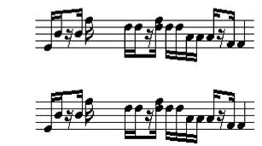
Sound File Formats
What is MIDI music?
Musical Instrument Digital Interface
  Classified as synthesized sound
  MIDI deals with music and synthesized sound, it does not handle voices or noise well
  Contains instructions for creating the pitch, volume and duration of notes that sound like various musical instruments
[Do some further reading: MIDI music Technology]
Disadvantage:
Does not produce high-quality vocals
Advantage:
Midi files are more compact.
Small File sizes, easy to edit and change
3 min of Midi music = 10 KB
3 min in another uncompressed waveform = 15 MB

Slide 25
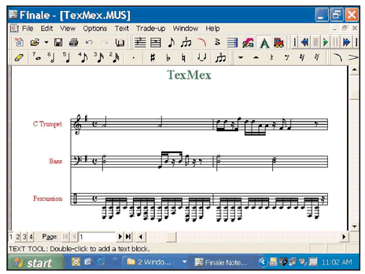
Sound File Formats – continued
MIDI FORMAT
Software such as Cakewalk, Cubase and Finale can be used to create and edit MIDI music.

Slide 26
Audio can be streamed too!
Downloadable Audio |  | Streamed Audio
Advantages | Disadvantages | Advantages | Disadvantages
Once downloaded, can be replayed, edited over and over (don’t need to wait again for download) | Takes a long time to download, especially for big files | Plays immediately | Cant rewind, pause, etc.
Don’t need a special streaming web server to post the file | Takes up disk space on the computer to store it | Consumes RAM only while being played, then purged after | Need a special server to post it
Example: Audio Files on Limewire |  | Example: cbc radio

Slide 27
Embedding Code into a Webpage
(1) Linking to the Sound file
  (Downloads the sound file and starts playing it once)
  <p>Download a <a href="dearmom.wav">sound file </a></p>
(2) Embed the sound file
  (Downloads the sound file but and starts playing once user clicks on the “Play”
  button it once)
  <embed src="dearmom.wav" autostart=“false" width="144" height="50“ loop="1">
  (Downloads the sound file and starts playing it automatically once)
  <embed src="dearmom.wav" autostart=“true" width="144" height="50" loop="1">

Slide 28



Animation
What is an animation?
  A drawing that moves, bringing the drawing
  to “life”
  A picture that create the illusion of movement when played in succession.
  Animation is a powerful tool capable of communicating complex ideas. E.g How the heart beats

Slide 29

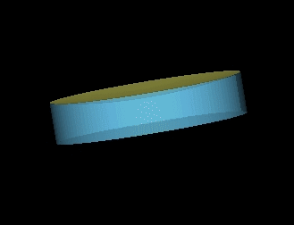
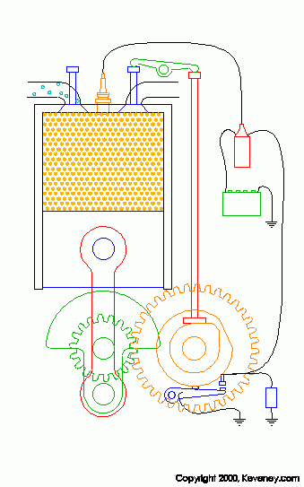

Animation
Why use animations? Animations are used in multimedia applications in order to achieve the following:
To provide action and realism: In Entertainment
To provide visualization and demonstration: In Education
Simulate or dramatization of real life process: In Training
To attract Attention.

Slide 30
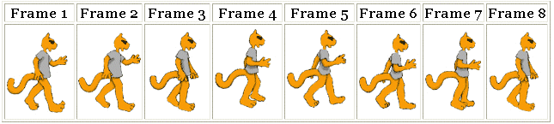

Animation
In animation, the perception of movement is an illusion. The movement that we see is made up of many still images each in its own frame like a movie.
Therefore, in animation we are talking of a Simulation of movement through a series of pictures that have objects in slightly different positions
Each drawing is called a “frame”
(a snapshot of what’s happening at a particular moment)
Required Frames Per Second FPS:
Facts:
Movies on film - 24 fps
TV – 30 fps
  9000 frames for five minute cartoon
Computer animation
can be effective at 12- 15 fps. Anything less produces “jerky” motion as the eye detects the changes from one frame to another

Slide 31
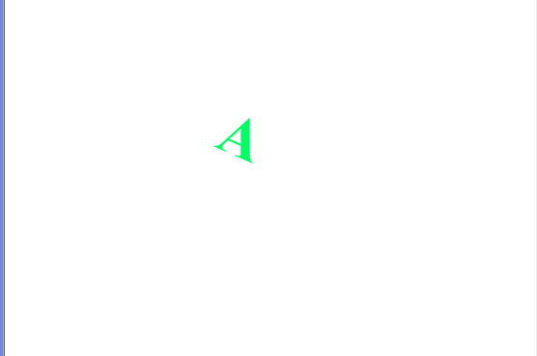

Animation
Frame Rate (Frames Per Second FPS)
Frame Rate: indicates the playback speed of the animation in frames per second
Low frame rate appears choppy

Slide 32
Types of Animation
Two types of animation exist:
2-D animation
    Cel animation
    Path animation
3-D animation

Slide 33

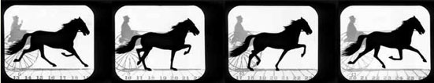
2-D Animation
2-D Animation → Cel-Based
“Cel” comes from celluliod – clear sheet material on which images were drawn by movie animators
(also called traditional animation, classical animation, hand-drawn animation, frame by frame animation)
Celluloid images placed on a stationary background.
Background remains fixed as Object changes from frame to frame
You can have more than one object moving against fixed background.
Computer based cel animation usually employs animation programs such as Toonz
Gaits of the Horse, by E. Muybridge (1834-1904)

Slide 34

2-D Animation
2-D Animation → Path Based Animation
Moves an object along a predetermined path on the screen.
The path could be straight line or any number of curves
Often the object does not change although it might be resized or rotated
Path animation can be easy to create as compared to cel animation because you need only one object, instead of several objects
In addition, you can use a multimedia authoring program to create the path by simply dragging the mouse pointer around the screen or by pointing different location on the screen and clicking the mouse buttons.
Some authoring programs allow an artist to set the objects beginning position on one frame and end its ending position on another frame. Then the program uses a process called “Tweening” to automatically fill the remaining position.

Slide 35
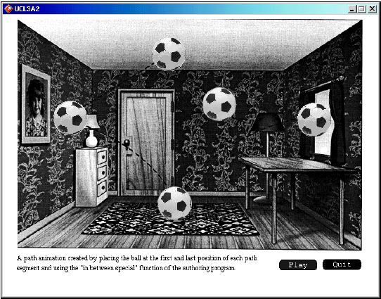
2-D Animation
2-D Animation → Path Based Animation
A path animation created by placing the ball at the first and last position of each path segment and using the “in between special ” function of the authoring program .

Slide 36
2-D Animation
2-D Animation → Issues
What does a bigger FPS imply?
  Larger file size
  More realistic motion
What can we do
to change the motion?
  If the animation appears too slow.
  If the motion is a bit too fast.

Slide 37
2-D Animation
2-D Animation → Some Terminology
  Tweening: Inbetweening or tweening is the process of generating intermediate frames between two images to give the appearance that the first image evolves smoothly into the second image.
  Key Frame: A key frame in animation and filmmaking is a drawing that defines the starting and ending points of any smooth transition. They are called "frames" because their position in time is measured in frames on a strip of film.

Slide 38
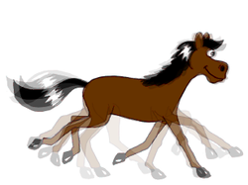
2-D Animation
2-D Animation → Some Terminology
  Onion skinning is a 2D computer graphics term for a technique used in creating animated cartoons and editing movies to see several frames at once.
Purpose: the animator or editor can make decisions on how to create or change an image based on the previous image in the sequence.

Slide 39
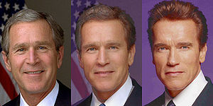
2-D Animation
2-D Animation → Some Terminology
  Morphing: It is a special effect in motion pictures and animations that changes (or morphs) one image into another through a seamless transition. Most often it is used to depict one person turning into another through technological means or as part of a fantasy or surreal sequence.
Three frames form a morph from George W. Bush to Arnold Schwarzenegger showing the mid-point between the two extremes

Slide 40
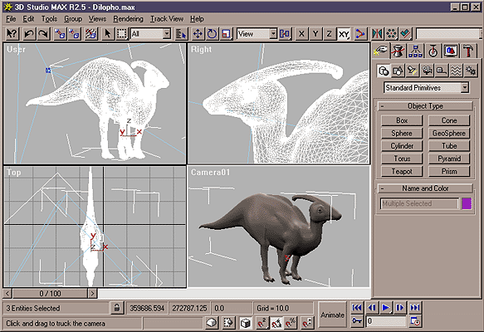
3-D Animation – Process
3-Dimensional animation involves 3 steps:
  Modelling
  Animating
  Rendering

Slide 41
3-D Animation - Process
Modelling:
  Process of creating broad contours and structure of 3D objects and scenes (draw views – top, side,
  cross section
Animating:
  Process of defining object motion.
  Defining lighting and perspective views to create change during animation
Rendering:
  Involves giving an object attributes such as
  color, surface textures, amounts of transparency
Sample Demo

Slide 42
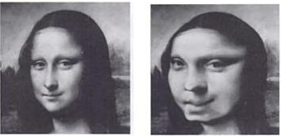
Animation → Some Special Effects
Warping:
  Distorts an image
  e.g. Warp frown into smile
http://www.cise.ufl.edu/~anand/students/chui/img/eg_face_warp_anim.gif

Slide 43
Animation → Some Special Effects
Morphing

Slide 44
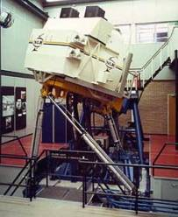
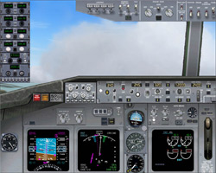
Animation → Some Special Effects
Virtual Reality: (VR)
Creates environment where user becomes part of the experience
Boeing: flight simulators of airplane cockpits (hydraulic controlled on legs)
CD based adventure games – point and go thru doors, stairs
Hand-held equipment allows person to interact with environment
A 2D cockpit for a Boeing 737. Some gauges are retained from the default MSFS 737, while others are modernized. Some non-functional controls are included in the dashboard.

Slide 45
Sources of Animation
Animation clip art websites available on Internet for free or at cost: http://www.animation-central.com/misc.htm
The ones for a cost are more professional and creative
Create each image that corresponds to a frame using a draw or paint program
Create animations with software (Photoshop, Flash)
Multimedia authoring programs like Macromedia Director allow you to easily create path animations

Slide 46
Animation Software
.swf originally meant “Shockwave Flash” but now “Small Web Format”
 | Animated GIF | Flash | Director
Created by | Depends | Flash | Director
Extension | Source depends .gif (movie) | .fla (source) .swf (movie) | .dir (source) .dcr (movie)
Size | Larger than normal gif | Vector images take up less space than GIF bitmapped images | Vector images take up less space than GIF bitmapped images
Uses | Banners, small areas | Interactive video, graphics, animation | More interactive sites
Need to play it | Nothing | Flash Player (Free and works with most browsers) | Web browser plug in (The Shockwave Player)
No sound
Sound
Sound

Slide 47
Animation on the Web
Animated Text:
Text can be animated in several ways. These actions include, zooming in and out, scrolling across the screen, distorting and blinking.
Animated GIFs:
GIFs are graphic file format for the web. Still images can be combined to create animation.
Macromedia Director applications:
Shockwave
3 – D Environments:
Virtual Reality Modeling Language (VRML) is a computer language used to create interactive 3 – D environments on the web that allows the user to move through space or explore an object.

Slide 48
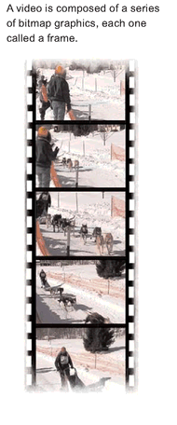
Video
Video uses the power of Motion and Sound
A sequence of still images or frames that create the illusion of movement when played in succession.

Slide 49
Types of Video
Analog Video:
E.g. Videotape, it is linear. It has the beginning, middle, and end. If you want to edit the frames, you need to rewind, pause and then fast forward to display the desired frames.
Digital Video:
Each frame is made up of pixels stored as 0s and 1s.

Slide 50

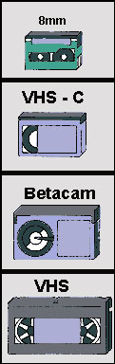
Summary: Analog vs Digital
1983
1994
DIGITAL (Newer Technology)
Records a binary code (string of 1s and 0s) compressed on magnetic tape or other media
Adv: No image degradation
Plug your video camera directly into your computer via a Firewire (aka i.Link) or USB connection.
These are digital connections and allow you to "dump" footage straight from the camera to hard drive.
ANALOG (Older Technology )
Records electrical signals/pulses directly onto a medium (like a tape) with a magnetic encoding.
Disadv: Picture loses quality
Video capture card needed to convert video from analog to digital for your computer
Solid State Media Card - Memory Sticks

Slide 51
Digital Video
Digital Video is composed of a series of bitmap graphics, each one is called a frame.
Characteristics:
Bits store color and brightness data for each video frame.
Retains image quality no matter how many times it is copied.
Easily manipulated on a pc because stored in digital format
“Digital Technology is the same revolution as adding sound to pictures and the same revolution as adding color to pictures. Nothing more and nothing less.”
- George Lucas, film maker of STAR Wars

Slide 52
What kinds of Digital Videos?
Classified by its platform or application (how it will be delivered)
  Desktop video (DTV)
    Videos constructed and displayed using a personal computer
  Web-based video
    Incorporated in Web pages and accessed with a browser
  DVD-video
    A DVD format used for commercial DVDs that contain feature-length films.
  PDA video
    Small-format video designed to be viewed on a PDA or cell phone screen

Slide 53
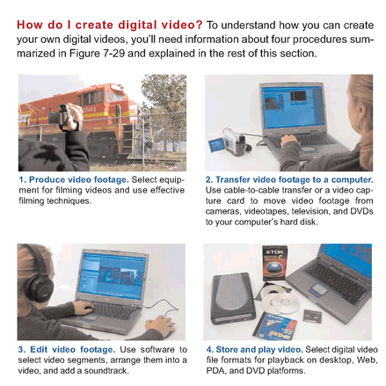
Creating Digital Video

Slide 54
Ready to Make a Video –
Assumption: you took the footage
Let’s take a closer look!
Capture Video
Download video from camcorder to computer
Edit
Digital Video
(using Computer,
Digital Video software
ex. Adobe Premiere, Avid)
Edit it
Add all kinds of cool titles
Filters, transitions
Superimpose clips
Synchronize audio with video
Authoring software: create menus and interactivity
Output Video
Output to different file formats
Back out to tape, the Web, CD, DVD

Slide 55
Capturing the Video with Camcorders
If we use an:
  Analog Camcorder,:
  Electronic impulses are recorded
  Must convert it to digital BEFORE we can put it on our computer to edit.
  To convert analog video to digital video we need a Video card
  Digital Video Camcorder:
  Information is sent as a set of 0s and 1s
  Thus no need to convert!

Slide 56


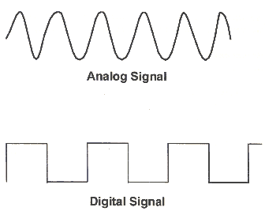
Capturing Video –
Download video from camcorder to computer
To use video in a multimedia application,
it must be in digital form (0s and 1s)
So how do you get a camcorder video into digitized form?
Analog Video camera
Video card
Software:
Capturing, Editing, Outputting
Connecting Leads:
Firewire or USB cable
Digital
camera

Slide 57
Digital Video Camcorders
Most Digital Video Camcorders (DV Camcorders), do a little bit of compression right inside the camera.
Common DV compression used by today’s camcorders: DV25 is the most
  DV25 Format Specs:
    Pixel Dimension is 720 X 480
    Frame Aspect Ratio either 4:3 or 16:9
    Data Rate: 25 mega bits per second (that’s why it is DV25)
    Frame Rate: 29.97 fps
    Colour Sampling: YUV 4:1:1

Slide 58
Digital Video Camcorders
Frame Aspect Ratio: The aspect ratio of an image is the ratio of the width of the image to its height, expressed as two numbers separated by a colon. That is, for an x:y aspect ratio, no matter how big or small the image is, if the width is divided into x units of equal length and the height is measured using this same length units.

Slide 59
Colour Compression In The Camera
For still images RGB is commonly used: RGB (Red, Green, Blue) describes what kind of light needs to be emitted to produce a given color.
For video the model is YUV (YIQ) or YCbCr (for MPEG compression)
  Y → luminanace (brightness)
  UV (C_{b}C_{r}) → chrominance (color/hue)
Question: Which one will the human eye detect changes in more easily? How does this help us with compression? (fill in the blank with Y, U or V)
Answer: ______.
Question: Black and White TV only used the signal (fill in the blank with Y, U or V)
Answer: ________.
Reference: http://en.wikipedia.org/wiki/Chroma_subsampling

Slide 60
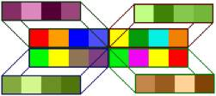
Color Sampling Method for Video
-compression technique
You may see that the compression used
4:1:1 4:2:0 4:4:4
What does this mean?
  Assume we have 4 pixels →
Color Sampling:
Refers to technique in digital video –compression technique
BACKGROUND: in Video we do not store record all color in an image
Color Sampling allows Averages out pixels to cut down on bandwidth (faster transfer rates)
Eye senstivity:
  Rods – light vs. dark, black vs. white -- not color
  Cones – see color
We can detect brightness better than color (more rods)

Slide 61
Color Sampling Method for Video
http://dvxuser.com/articles/colorspace/
Color Sampling Method | Amount of Y (luminance) | Amount of U (color or hue) | Amount of V (color or hue) | Amount of Compression | Used in
4:4:4 | 4 samples | 4 samples | 4 samples | None 12 samples for each group of 4 pixels
4:2:2 | 4 samples | 2 samples | 2 samples | Reduced from 12 samples to 8, 33% reduction in storage | Digital Betacam format
4:2:0 | 4 samples | 2 samples of either U or V, one scan line of U, then one scan line of V |  | 12 to 6, 50% reduction in storage | HDV, MPEG-1, DVD, MPEG-2, PAL DV
4:1:1 | 4 samples | 1 sample | 1 sample | 12 to 6, 50% reduction in storage | NTSC DV, miniDV digital camcorder

Slide 62
A little history on TVs
Digital video often adheres to standards for TV broadcasting – 2 standards
NTSC Standard:
  Regular Analog TV broadcasting began in the United States in 1939 and carried through to today
  Frame rate was originally 30fps but when color was introduced, needed to go down to _______ fps to accommodate for colour information.
PAL Standard:
  Britain, Europe and other countries
  Frame rate is set for _________ fps

Slide 63
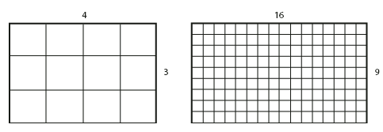
NTSC Standards
High Definition for NTSC:
  1440 X 1080
  1280 X 720
  Frame Aspect Ratio is 16:9
  1440:1080 → ratio is 1.333 (pixels are not square)
  1280:720 → ratio is 16:9 (pixel are square ☺)
  NTSC Standard DV Frame:
  For NTSC → 720 X 480 pixels
  For Pal → 720 X 576 pixels
  Pixels are distorted (not square) because 720:480 is actually 3:2 ratio
Frame aspect ratio is the ratio of width to height of the image frame.
4:3 Frame aspect ratio
16:9 Frame aspect ratio

Slide 64
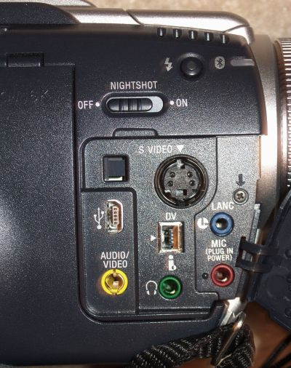
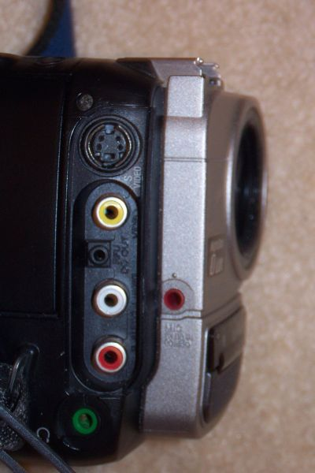
Connection Types:
Analog
Digital
Video
S video
(better quality)
Yellow RCA
Firewire
connection
Audio
Sony Hi-8
TRV-80
http://computer.howstuffworks.com/question371.htm

Slide 65
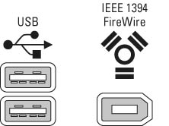
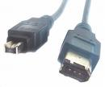
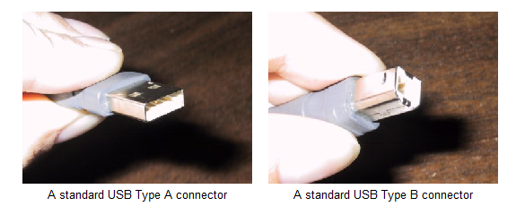
Firewire vs. USB
It used to take A LONG time to move video from your camcorder to your computer (Hours and Hours)
Firewire
  Firewire initiated by Apple and the IEEE in the late 80s.
  It is a high speed data transfer technology.
  Transmitted originally at 400Mbps
  Apple wanted to charge 1 dollar for every machine that was going to use it, this caused most PC manufacturers to decide against it, in favour of USB 1.1.
Currently, we have Firewire 800, transmits at 800 Mbps, at some point in the future, they expect new Firewire will transmit at 3.2 Gbps!
USB
  USB 1.1. could transmit at 12Mbps
    Used for mice, keyboards, printers, _____________
  USB 2.0 came along, backward compatible, transmitted at 480Mbps (could beat with Firewire400 and do video)
Apple IPODS no longer have firewire ports

Slide 66
Capturing Video
Download video from camcorder to computer
Benefits of Digital
No Loss of Quality – Digital Videotape can be copied almost indefinitly. Important consideration in Postproduction sessions that require numerous generations of video effects.
No need of analog-to-digital conversion
Digital material can be directly uploaded to digital editing systems
Reduces or eliminates problems such as dropouts due to error-correction circuitry associated with digital electronics
Archival (long-term) storage.
Digital videotapes are better suited for longer periods
Quality of digital recordings is significantly better than analog recordings

Slide 67
Capturing Video
Download video from camcorder to computer
Controlling the Transfer Process
Video Capture software: Doesn’t matter if you are using
an analog or digital camera
Software Should have Features:
Start and stop the transfer
Select a file format for storing your video footage
Specify file name for each video clip
Video capture software is supplied with video editing software and with video capture devices
TIP: Videos are easier to edit if you divide them into several files, each containing a one or two minute video clip.

Slide 68
Thank You All

